Slide 1
Case study 2:
Rural communities in Ireland
what can we apply?
Irene Fernández García
Water & Energy in Rural Communities, 26th April 2018

Slide 2
Background
Why?
Ireland target
Energy efficiency
GH emissions
Strategies
Renewable energy
Proposal for a Directive of the European Parliament and of the council on the quality of water intended for human consumption (01/02/2018)
Contribution to the transition to a circular economy:
Manage drinking water considering efficiency and sustainability to reduce energy use and unnecessary water loss.
GWS
Drinking water supply networks in rural areas (Ireland).
> 400 GWSs across Ireland.
Users: 9 % population in Ireland.
Private source of water or connected to Irish Water.
Most GWSs operate by gravity → MHP potential.

Slide 3
Objectives
Improve both water and energy use efficiency in GWSs
1. Micro-hydropower energy recovery.
2. Energy optimization.
Water savings by leakage reduction

Slide 4
Methodology
Economic analysis
 | Network | Strategy | Strategy application | Energy Saving/ Generation | Water Saving by leakage
Sce. 1 | Gravity | Hydropower |  | + | x
 | Pressurized | - | Current operation | x | x
Sce. 2 | Gravity | Hydropower |  | ++ | +
 | Pressurized | Energy optimization |  | + | +
PRV
BPT
PAT
New potential sites
PAT
Pressure head

Slide 5
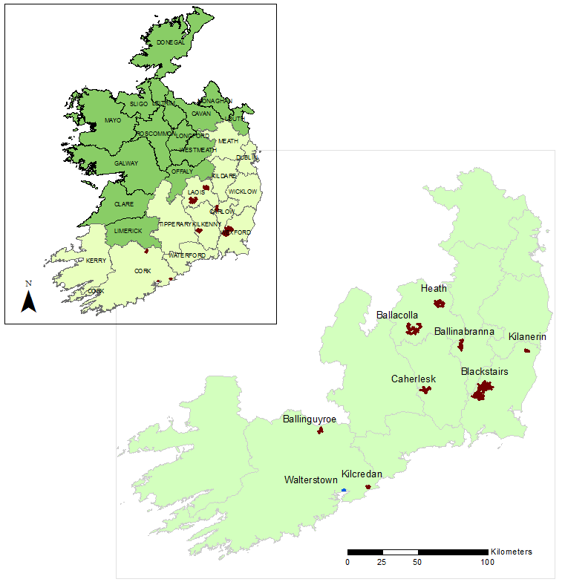
Case study: GWSs

Slide 6
Case study: GWSs
 | Average flow (l s⁻¹) | Nodes | Pressure head (m) | Node elevation, min (m) | Node elevation, max (m) | PRV | BPT
Ballacolla | 7.03 | 49 | 145 | 79 | 145 | 2 | 0
Ballinabranna | 2.02 | 44 | 190 | 47 | 164 | 3 | 0
Ballinguyroe | 1.99 | 72 | 146 | 75 | 138 | 0 | 0
Blackstairs | 13.76 | 122 | 277 | 51 | 271 | 3 | 8
Caherlesk | 2.40 | 150 | 120 | 66 | 115 | 0 | 0
Heath | 3.07 | 70 | 180 | 81 | 164 | 6 | 0
Kilanerin | 1.76 | 27 | 190 | 60 | 176 | 2 | 1
Kilcredan | 1.70 | 45 | 87 | 29 | 82 | 0 | 0
Walterstown | 0.28 | 49 | 63 + 40 | 58 | 80 | 0 | 0

Slide 7
Results
Location of current PRVs and potential sites
Ballacolla GWS
2 potential sites
Ballinabranna GWS
1 potential site
1. Micro-hydropower energy recovery

Slide 8
Results
Location of current PRVs and potential sites
Ballinguyroe GWS
2 potential sites
Blackstairs GWS
6 potential sites
1. Micro-hydropower energy recovery

Slide 9
Results
Location of current PRVs and potential sites
Caherlesk GWS
2 potential sites
Kilanerin GWS
1 potential site
1. Micro-hydropower energy recovery

Slide 10
Results
Location of current PRVs and potential sites
↓ pressure setting
Heath GWS
Kilcredan GWS
3 potential sites
1. Micro-hydropower energy recovery

Slide 11
Results
Micro-hydropower generation
1. Micro-hydropower energy recovery

Slide 12
Results
Energy recovery
1. Micro-hydropower energy recovery

Slide 13
Results
Water and cost savings in Sce2
1. Micro-hydropower energy recovery

Slide 14
Results
Economic analysis
Feasible sites*
 | Ballacolla | Ballinabranna | Ballinguyroe | Blackstairs | Caherlesk | Heath | Kilanerin | Kilcredan
Sce1 | 0 | 2 | 0 | 8 | 0 | 1 | 1 | 0
Sce2 | 2 | 3 | 2 | 12 | 2 | 6 | 2 | 3
* Sites with payback period lower than 10 years.
1. Micro-hydropower energy recovery

Slide 15
Results
PRV or PAT?
1. Micro-hydropower energy recovery

Slide 16
Results
Walterstown GWS
Pressure head at pump station: 40 m
2. Energy optimization

Slide 17
Results
Walterstown GWS
Optimal pressure head at the pump, Hop, to ensure 10 m at nodes:
Hop= 27 m
Annual energy saving: 833 kWh (39 %)
Annual cost saving: 141 €
Water and cost savings
Total savings
454 €
Annual water savings: 1046 m³
Annual cost saving: 314 €
Current pumping cost (distribution)
363 €
2. Energy optimization

Slide 18
Conclusions
Overall, the hydropower potential in GWSs is low.
Blackstairs: 2 potential sites (site 1> 6 kW; site 2> 1 kW).
High water saving and water cost saving after installing new elements to reduce pressure in the network.

Slide 19
Case study 2: Adoption of water and energy saving measures in GWSs
Questions
Q0: Do you have a hydraulic model of the network?
Q1: Why have not these measures been implemented yet?
Q2: Barriers to adoption of water/ energy saving measures.
Q3: How can we make it happen?

Slide 20
Case study: GWSs
Key protagonists
GWSs
1. End users
3. Capital funder
4. Designer
5. Operator
2. Policy makers
Average total energy cost/ connection: 76 € (40 %).
Water costs.
EPS.
Department of Housing, Planning and Local Government.
Departments of Finance & Housing, Planning and Local Government.
Engineering consultancy.
Dwr Uisce team.

Slide 21
Case study: GWSs
To consider…
Protagonist No 1 | Low | Low to moderate | Moderate | Moderate to high | High
How would you rate their Interest level in adopting measures to improve both water and energy use in GWSs?
How would you rate Power they have in influencing the adoption of measures to improve both water and energy use in GWSs?
Does this protagonist prioritise… | Yes | No
Environment/Planet
People
Profits

Slide 22
Case study: GWSs
Who has the power?
High Power
Low interest
High Power
High interest
Power/ Influence of Protagonist
Low Power
Low interest
Low Power
High interest
Interest of Protagonist
Interest-Influence Matrix (Mendelow, 1991)

Slide 23
Case study: GWSs
Where is the influence focused?
Triple bottom line (Elkington, 1994)

Slide 24
Case study 2: Adoption of water and energy saving measures in GWSs
Discuss the case in your group

Slide 25
Case study: GWSs
Positioning protagonists on the interest influence matrix
Protagonist 1
Why?
Why?
Why?
Protagonist 2
Why?
Why?
Why?
Power/ Influence of Protagonist
Protagonist 3
Why?
Why?
Why?
Protagonist 4
Why?
Why?
Why?
Interest-Influence Matrix (Mendelow, 1991)
Interest of Protagonist

Slide 26
Case study 2:
Rural communities in Ireland
what can we apply?
Irene Fernández García (fernanir@tcd.ie)
Water & Energy in Rural Communities, 26th April 2018

