Slide 1
Dŵr Uisce Annual Conference 2018
Water & Energy Innovation
23rd October

Slide 2
Introduction to Dŵr Uisce
Significant scope to improve the energy efficiency of the distribution of water resources.
The Dŵr Uisce project aims to quantify and demonstrate this scope using:
Smart and low-carbon technology.
Cross-sectoral & cross-border benchmarking, and economical and environmental impact assessment
Networking, dissemination, knowledge exchange, brokerage events, demonstrations.
The project will deliver improved efficiency of the water-energy nexus, benefitting two key stakeholders groups: water suppliers and water consumers

Slide 3
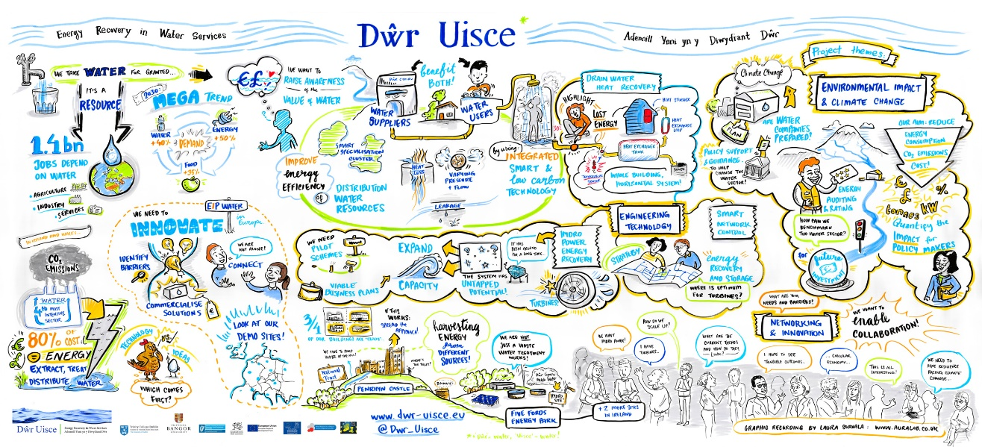

Slide 4
The Dŵr Uisce project
Dŵr Uisce
Water - Energy Challenges
Life Cycle Assessment & Eco-Design
Hydropower
Energy Recovery
Benchmarking of Energy Efficiency measures
Drain Water Heat Recovery
Smart Network Control
Energy Auditing & Rating
Economic & Environmental Impact Assessment
Smart Specialisation Cluster
Dissemination & Collaboration
Technology Platforms
Climate Change
Policy Support & Guidance

Slide 5
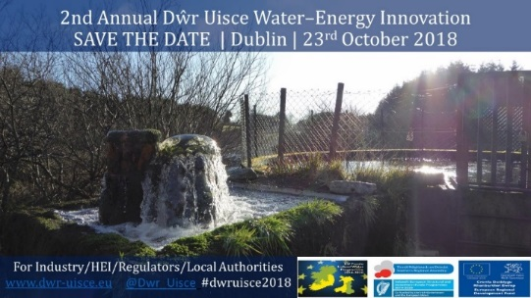
Dŵr Uisce Water-Energy
Innovation Conference:
Section Innovation Opportunities.
09:30 to 11:30 am
Innovation Opportunities (Chair: Prysor Williams) | 09.30 – 09.40 | Aonghus McNabola, Trinity College Dublin. Dŵr Uisce 'Distributing our Water Resources: Utilising Integrated, Smart and low-Carbon Energy'.
 | 09.40 – 10.10 | Paul O’Callaghan, BlueTech Research. (Private Sector).
 | 10.10 – 10.30 | Mike Pedley, “Back to the Future - via the Present: progress and challenges for energy in the UK Water Industry”. (Private Sector).
 | 10.30 – 10.40 | Innovation Opportunities– Q&A
 | 10.40 – 11.30 | 2-min Water, Energy and Innovation: Intersectoral pitches.
#dwruisce2018

Slide 6
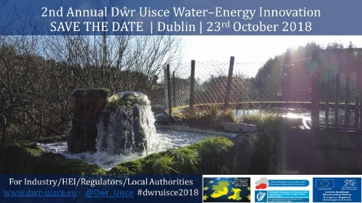
Dŵr Uisce Water-Energy
Innovation Conference:
Section Innovation in Practice.
12:00 to 13:15 pm
Innovation in Practice (Chair: Aonghus McNabola) | 12.00 – 12.15 | Triona Collins, “Engaging with the Rural Water Community: I Must Do Something”, Water Services, Tipperary County Council. (Communities Sector).
 | 12.15– 12.30 | John Durkan, “Doing more with less”. ABP Food Group. (Food Sector).
 | 12.30 – 12.45 | Benny McDonagh, “Rethinking Energy”, EPS Group. (Energy and Water Treatment Supply Sectors).
 | 12:45 – 13:00 | John Gallagher & Paul Coughlan, “Innovating for low‐carbon energy through hydropower”. Trinity College Dublin. (Conservation Charity Sector).
 | 13:00 –13:15 | Innovation and Practice – Q&A
#dwruisce2018

Slide 7
Dŵr Uisce Water-Energy
Innovation Conference:
Section Demonstrating Learning.
14:10 to 15:30 pm
Demonstrating Learning (Chair: Paul Coughlan) | 14.10 – 14.30 | Dŵr Uisce Hydropower Demonstration sites. “Blackstairs Group Water Scheme, Ireland & Tŷ Mawr Wybrnant, National Trust, Wales”. Daniele Novara, Trinity College Dublin.
 | 14.30 – 14:50 | Dŵr Uisce Heat Recovery Demonstration sites. “Penrhyn Castle, National Trust, Wales”. Isabel Schestak & Jan Spriet, Bangor University & Trinity College Dublin.
 | 14.50 –15:10 | Demonstrating Cluster Growth. “Demonstrating learning in action in a water and energy smart specialisation cluster”. Ana de Almeida Kumlien, Trinity College Dublin.
 | 15.10 – 15:20 | Demonstrating Learning – Q&A
 | 15.20 – 15.30 | Aonghus McNabola, Dŵr Uisce project, Trinity College Dublin. Closing remarks & call for action.
#dwruisce2018

Slide 8
use #dwruisce2018 use #dwruisce2018
tag: @Dwr_Uisce tag: theDŵr Uisce team
Tags us on social media and share today’s good news!

